Slide 1
Practice Lab:
This Practice Lab is dependent on Discussion Unit 7578, where most of the objects we create in this lab were introduced.
In this Practice Lab, we use CassandraSQLContext to read from (customer, orders, items), and populate a DSE Core table containing attributes from all 3, including an aggregate.
Witness predicate pushdown
Witness optimization
DSE Analytics, DataFrames
Notes:
The goal of this Practice Lab is to:
In this Practice Lab, we use CassandraSQLContext to read from (customer, orders, items), and populate a DSE Core table containing attributes from all 3, including an aggregate.
Witness predicate pushdown
Witness optimization

Slide 2
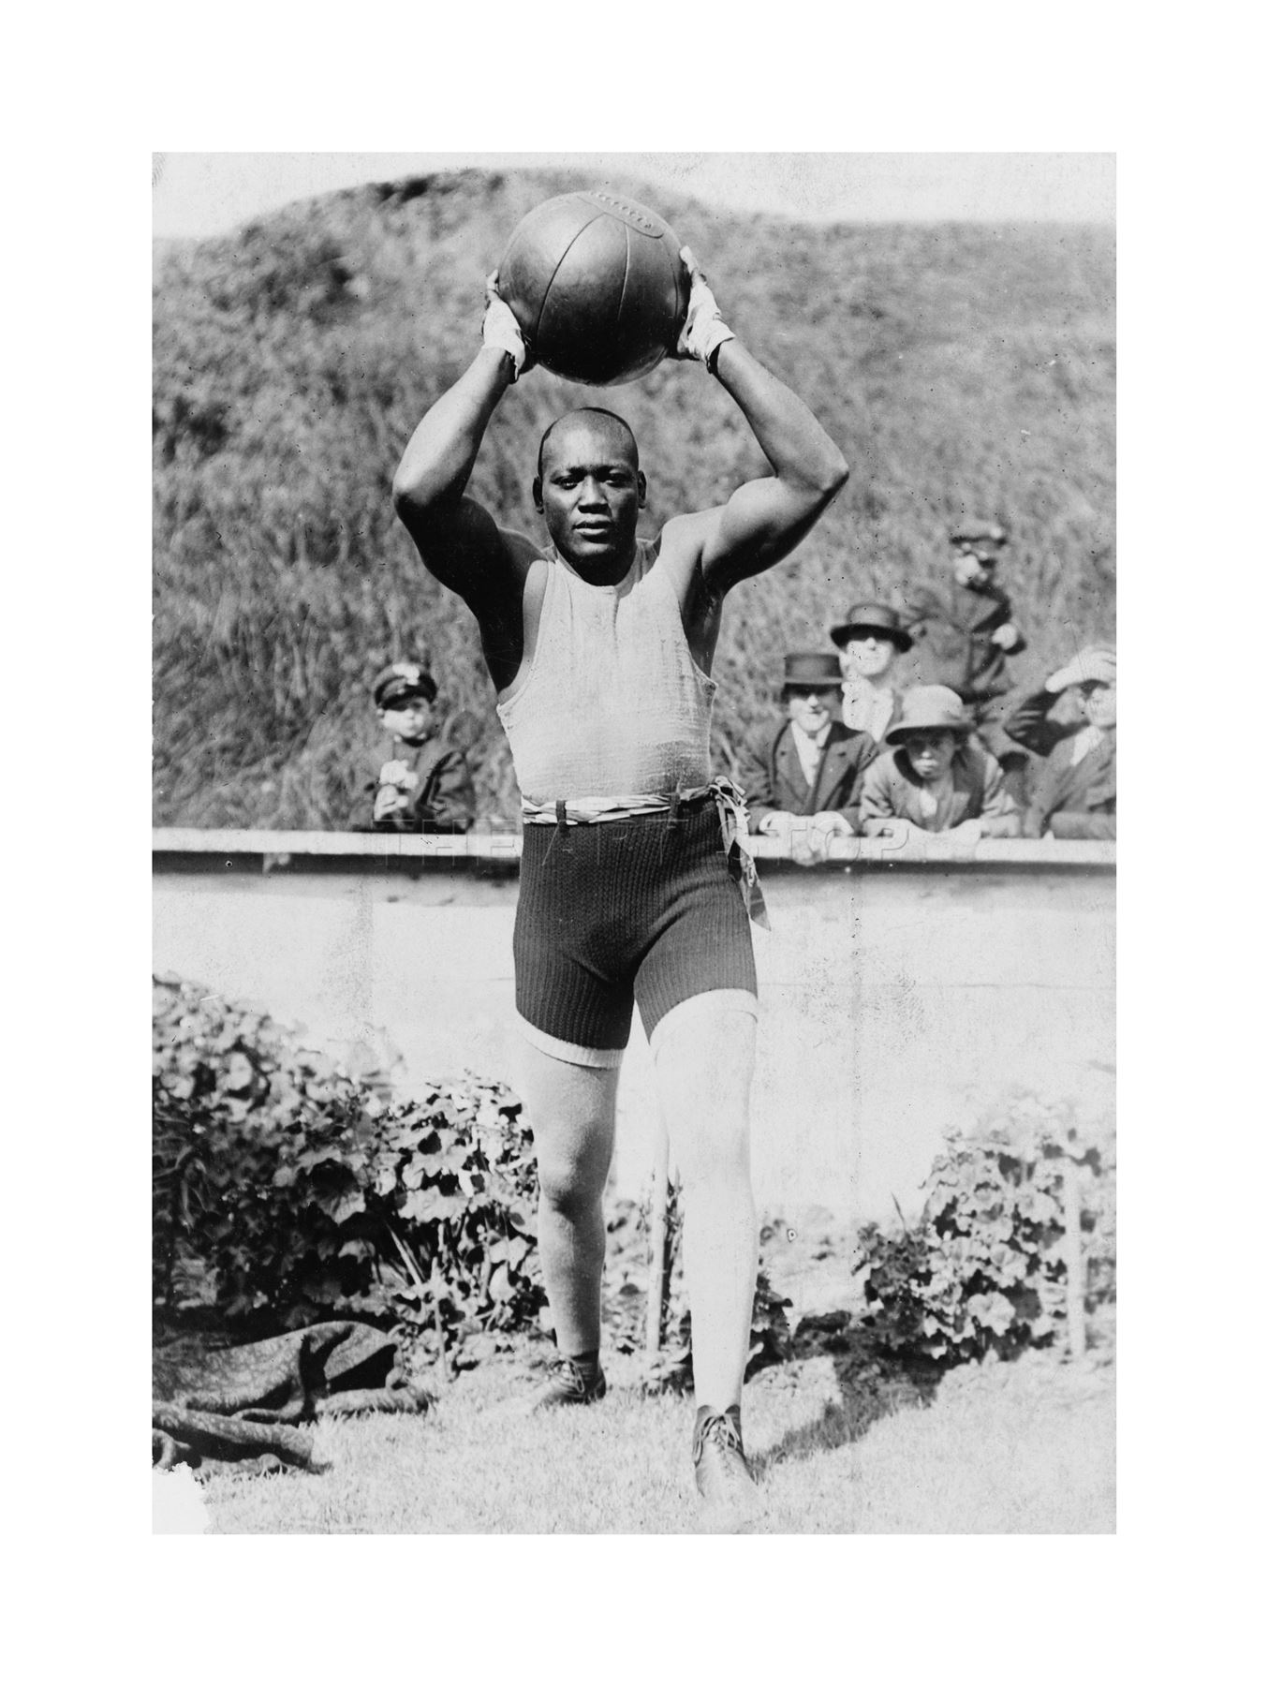
Challenge 1: Prerequisites
Prerequisites:
Instructions are provided for Linux
We will operate below recommended settings; 1 OS node only, minimum 8 GB RAM, 12 GB RAM preferred
That you have an operating single node DSE Core cluster with DSE Analytics enabled.
All work done as ‘root’
Notes:
To complete this Practice Lab, the following is assumed:
All prerequisites and conditions as listed above.
All work is expected to be executed on one OS node (instructions are written for Linux).
Because of resource constraints, it is expected you are running a single DSE Core node (no Graph, yes Analytics/Spark, no Search) on this single OS node.

Slide 3

Working Goal:
From: Maury_Atwater
To: DSE_HOTSHOT
Subject: Need this now !!!
Big deal. You previously loaded customer_orders. ☹
Now join the SQL modeled customer, orders, and items, and load the DSE modeled customer_orders2. We need order_total, calculated from items (quantity * price).
I also need Jobs that show:
. Predicate pushdown
. Optimization
-MA
Maury Atwater, President of Atwater's
Notes:
The email above, lists our working goal.

Slide 4



Challenge 1: Load DSE from 3 (SQL) tables
In Practice Lab 7545 we loaded (customers, orders, items); largely one CSV file per one SQL modeled table.
In Practice Lab 7571, we joined (customer and orders) and loaded a merged DSE table titled, customer_orders.
Now we need to load customer_orders2 from all 3 SQL tables.
Data from the third table, items, will be calculated; order_total (from items: quantity * price)
Use CassandraSQLContext
Use the Spark REPL
Notes:
Relative to Challenge 1:
Previously we loaded customer_orders using RDDs, and reading from customer and orders.
Now we'll use DataFrames and CassandraSQLConnect. To keep it simple, we'll return to the base customer, orders and items.
And we'll write to a new CQL table; customer_orders2.
The only column(s) from items are used in an aggregate expression; quantity * price
After (n) minutes, a partial cheat is offered at the end of this Practice Lab.

Slide 5


Challenge 1: SQL/CQL Assets
DROP KEYSPACE IF EXISTS ks_7579;
CREATE KEYSPACE ks_7579 WITH REPLICATION =
{'class': 'SimpleStrategy',
'replication_factor': 1};
USE ks_7579;
Notes:
Creating the keyspace.

Slide 6
Challenge 1: SQL/CQL Assets
CREATE TABLE customer
(
customer_num INT PRIMARY KEY,
fname TEXT,
lname TEXT,
company TEXT,
address1 TEXT,
address2 TEXT,
city TEXT,
state TEXT,
zipcode TEXT,
phone TEXT
);
Notes:
Creating customer.

Slide 7
Challenge 1: SQL/CQL Assets
CREATE TABLE orders
(
order_num INT PRIMARY KEY,
order_date TEXT,
customer_num INT,
ship_instruct TEXT,
backlog TEXT,
po_num TEXT,
ship_date TEXT,
ship_weight TEXT,
ship_charge TEXT,
paid_date TEXT
);
Notes:
Creating orders.

Slide 8
Challenge 1: SQL/CQL Assets
CREATE TABLE items
(
item_num INT,
order_num INT,
stock_num INT,
manu_code TEXT,
quantity INT,
total_price FLOAT,
PRIMARY KEY ((order_num), item_num)
);
Notes:
Creating items.

Slide 9

Challenge 1: SQL/CQL Assets
CREATE TABLE customer_orders2
(
order_num INT,
paid_date TEXT,
//
customer_num INT,
state TEXT,
order_total FLOAT,
PRIMARY KEY((order_num), customer_num)
);
All columns need a value copied or derived from the 3 source tables.
Notes:
Creating our target table; customer_order2.
order_total is to be calculated from items; quantity * price

Slide 10

Challenge 1: More ..
After (n) minutes, cheat; there is a partial solution at the end of this unit (a 2 table/incomplete solution)
Save your work, you'll need it later.
Notes:
After (n) minutes (and if you're stuck), consider cheating; a partital solution is offered at the end of the unit.
Save your work; Challenge 4 has you port your Challenge 1 statements to a real Scala program, compile and run.

Slide 11
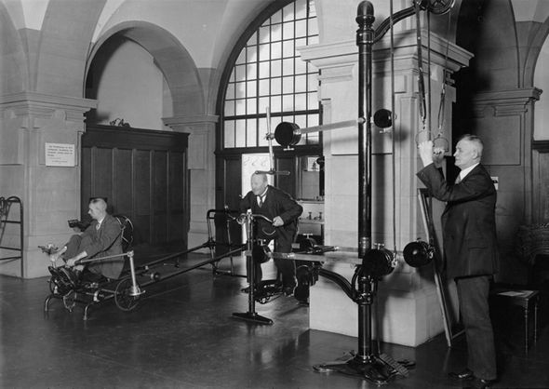
Challenge 2: Predicate Pushdown
Create the entire runtime environment to replicate the predicate pushdown example from Discussion Unit 7578
You need/want two DataFrames; Show qualifying and not qualifying.
Notes:
Challenge 2-

Slide 12
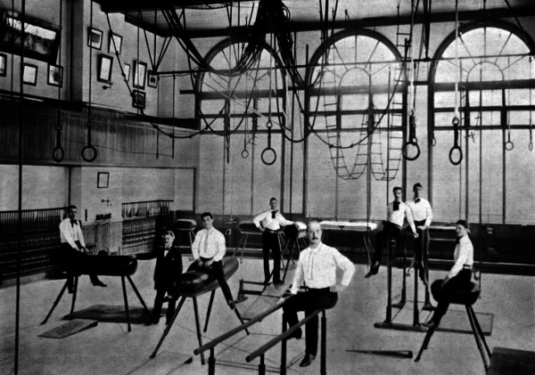
Challenge 3: DAG Optimization
Create the entire runtime environment to replicate the DAG Optimization (sort before filter) example from Discussion Unit 7578
You need/want two DataFrames; One to sort, and a second that filters from the first.
Notes:
Challenge 3-

Slide 13

Challenge 4 (Optional): Port Challenge 1 to IDE
Take the steps you used to complete challenge 1, and move them to a true Scala program.
Compile and run using the Eclipse/IDE steps outlined in Practice Lab 7554.
Notes:
Challenge 4, optional-
Take your statements from Challenge 1, and port to a real Scala program.
Practice Lab 7554 offers a pretty complete shell; the challenge should become the imports, and time.
You might need to add; import org.apache.spark.sql.cassandra.CassandraSQLContext. And other imports as displayed in Discussion Unit 7578.

Slide 14

Practice Lab:
Lessons Learned
Notes:
Discuss what worked well, poorly, from the Practice Lab.

Slide 15
End of Unit:
Notes:
End of Practice Lab-

Slide 16
Additional Detail:
Notes:
The remaining content may be read “extra credit”, as time allows.

Slide 17
Challenge 1: Hint
val recs_DF = spark.
sql(
"SELECT " +
" t2.order_num, " +
" (t3.quantity * t3.total_price) as order_total " +
"FROM " +
" ks_7579.orders t2, " +
" ks_7579.items t3 " +
"WHERE " +
" t2.order_num = " +
" t3.order_num " +
"GROUP BY " +
" t2.order_num, " +
" order_total "
)
Notes:
Hint to Challenge 1:
You need to add customer, and additional columns to fill customer_orders2.

